Slide 1
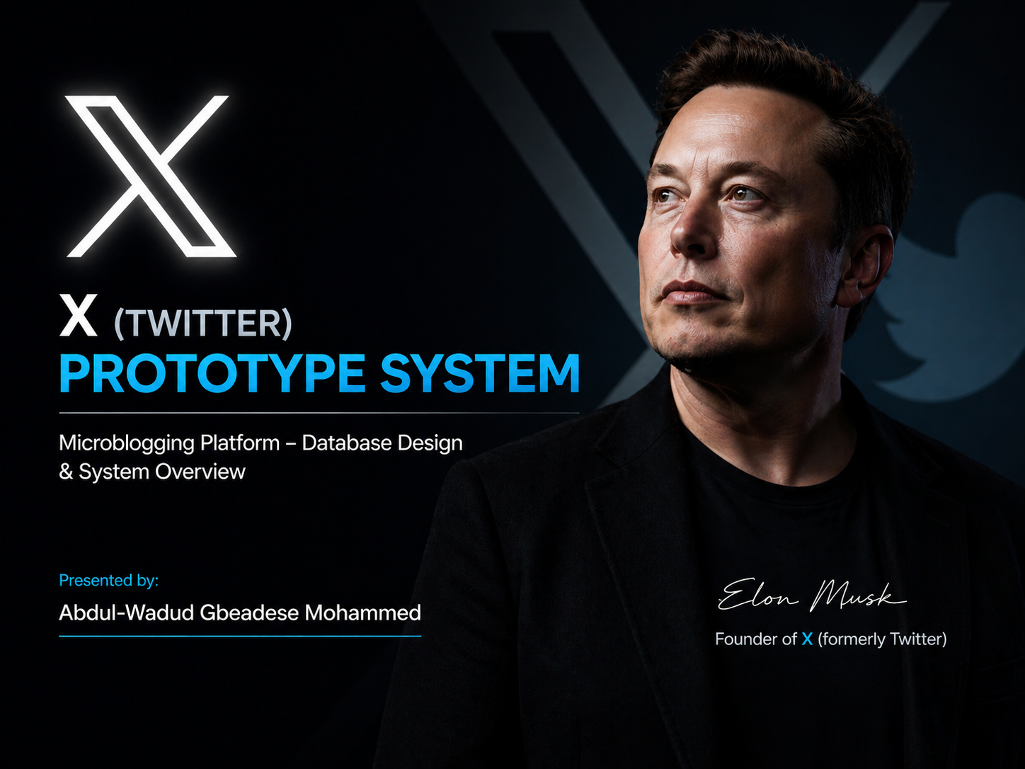

Slide 2
Introduction
This project is a prototype of a microblogging platform inspired by Twitter (X). It allows users to create short posts, interact with others, and view personalized content.

Slide 3
Purpose Of The Application
Enable users to share short messages
Allow social interaction between users
Provide a personalized content feed
Demonstrate relational database design using PostgreSQL

Slide 4
Core Features
1. User Registration & Login
2. Create Posts (Tweets)
3. Follow / Unfollow Users
4. Like Posts
5. Comment on Posts
6. Personalized Timeline

Slide 5
What the System Does
Post content
Follow other users
View posts from followed users
Interact through likes and comments

Slide 6
Technology Stack
Backend: Python (Flask/Django)
Frontend: HTML, CSS, JavaScript
Database: PostgreSQL

Slide 7
Database Overview
Using a relational database to store and manage data
efficiently.
Main Table:
User
Posts Follows
Likes
Comments

Slide 8
Relationships
One User → Many Posts
Users ←→Users ( Follow) →Many to Many
Users ←→Posts (Likes) →Many-to-Many
One Post → Many Comments

Slide 9
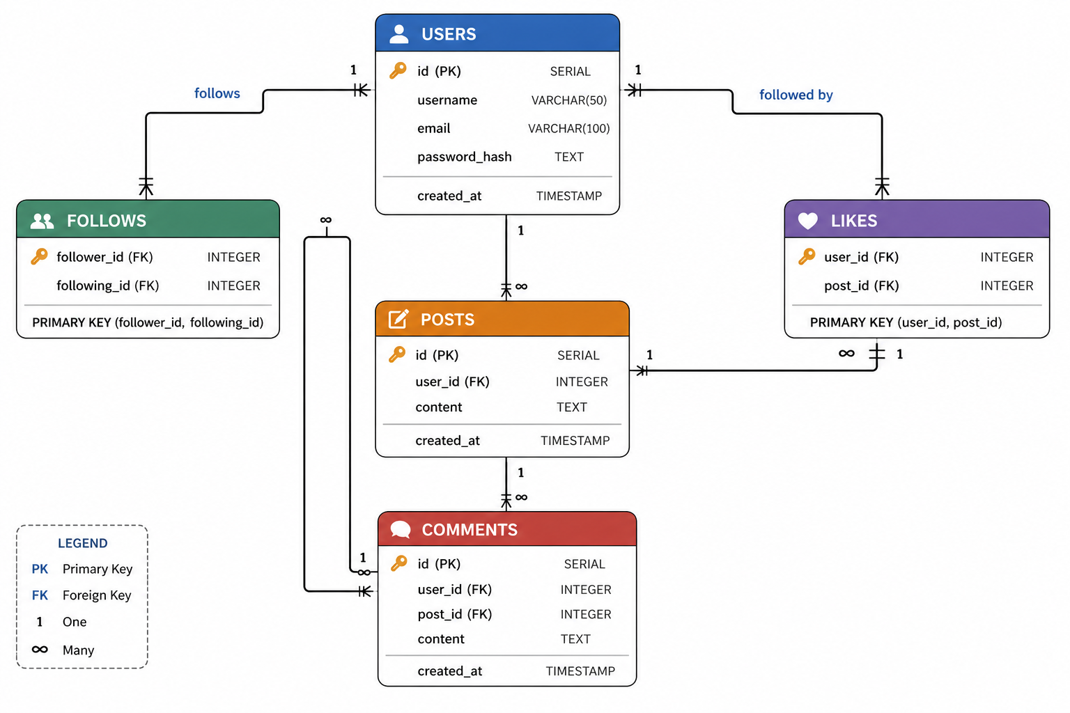
ER Diagram

Slide 10
Why PostgreSQL
Strong data integrity
Supports relationships ( foreign keys)
Handles complex queries
Scalable for real world applications

Slide 11
Conclusion
This project demonstrates how a social media system can be
designed using relational database, focusing on user interaction
and structured data relationships

